Slide 1
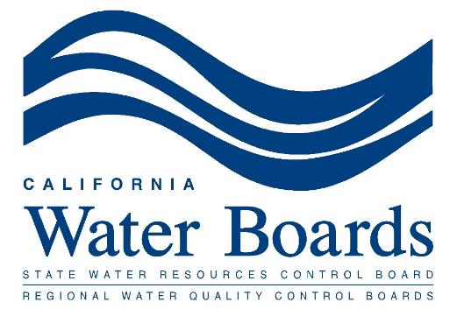
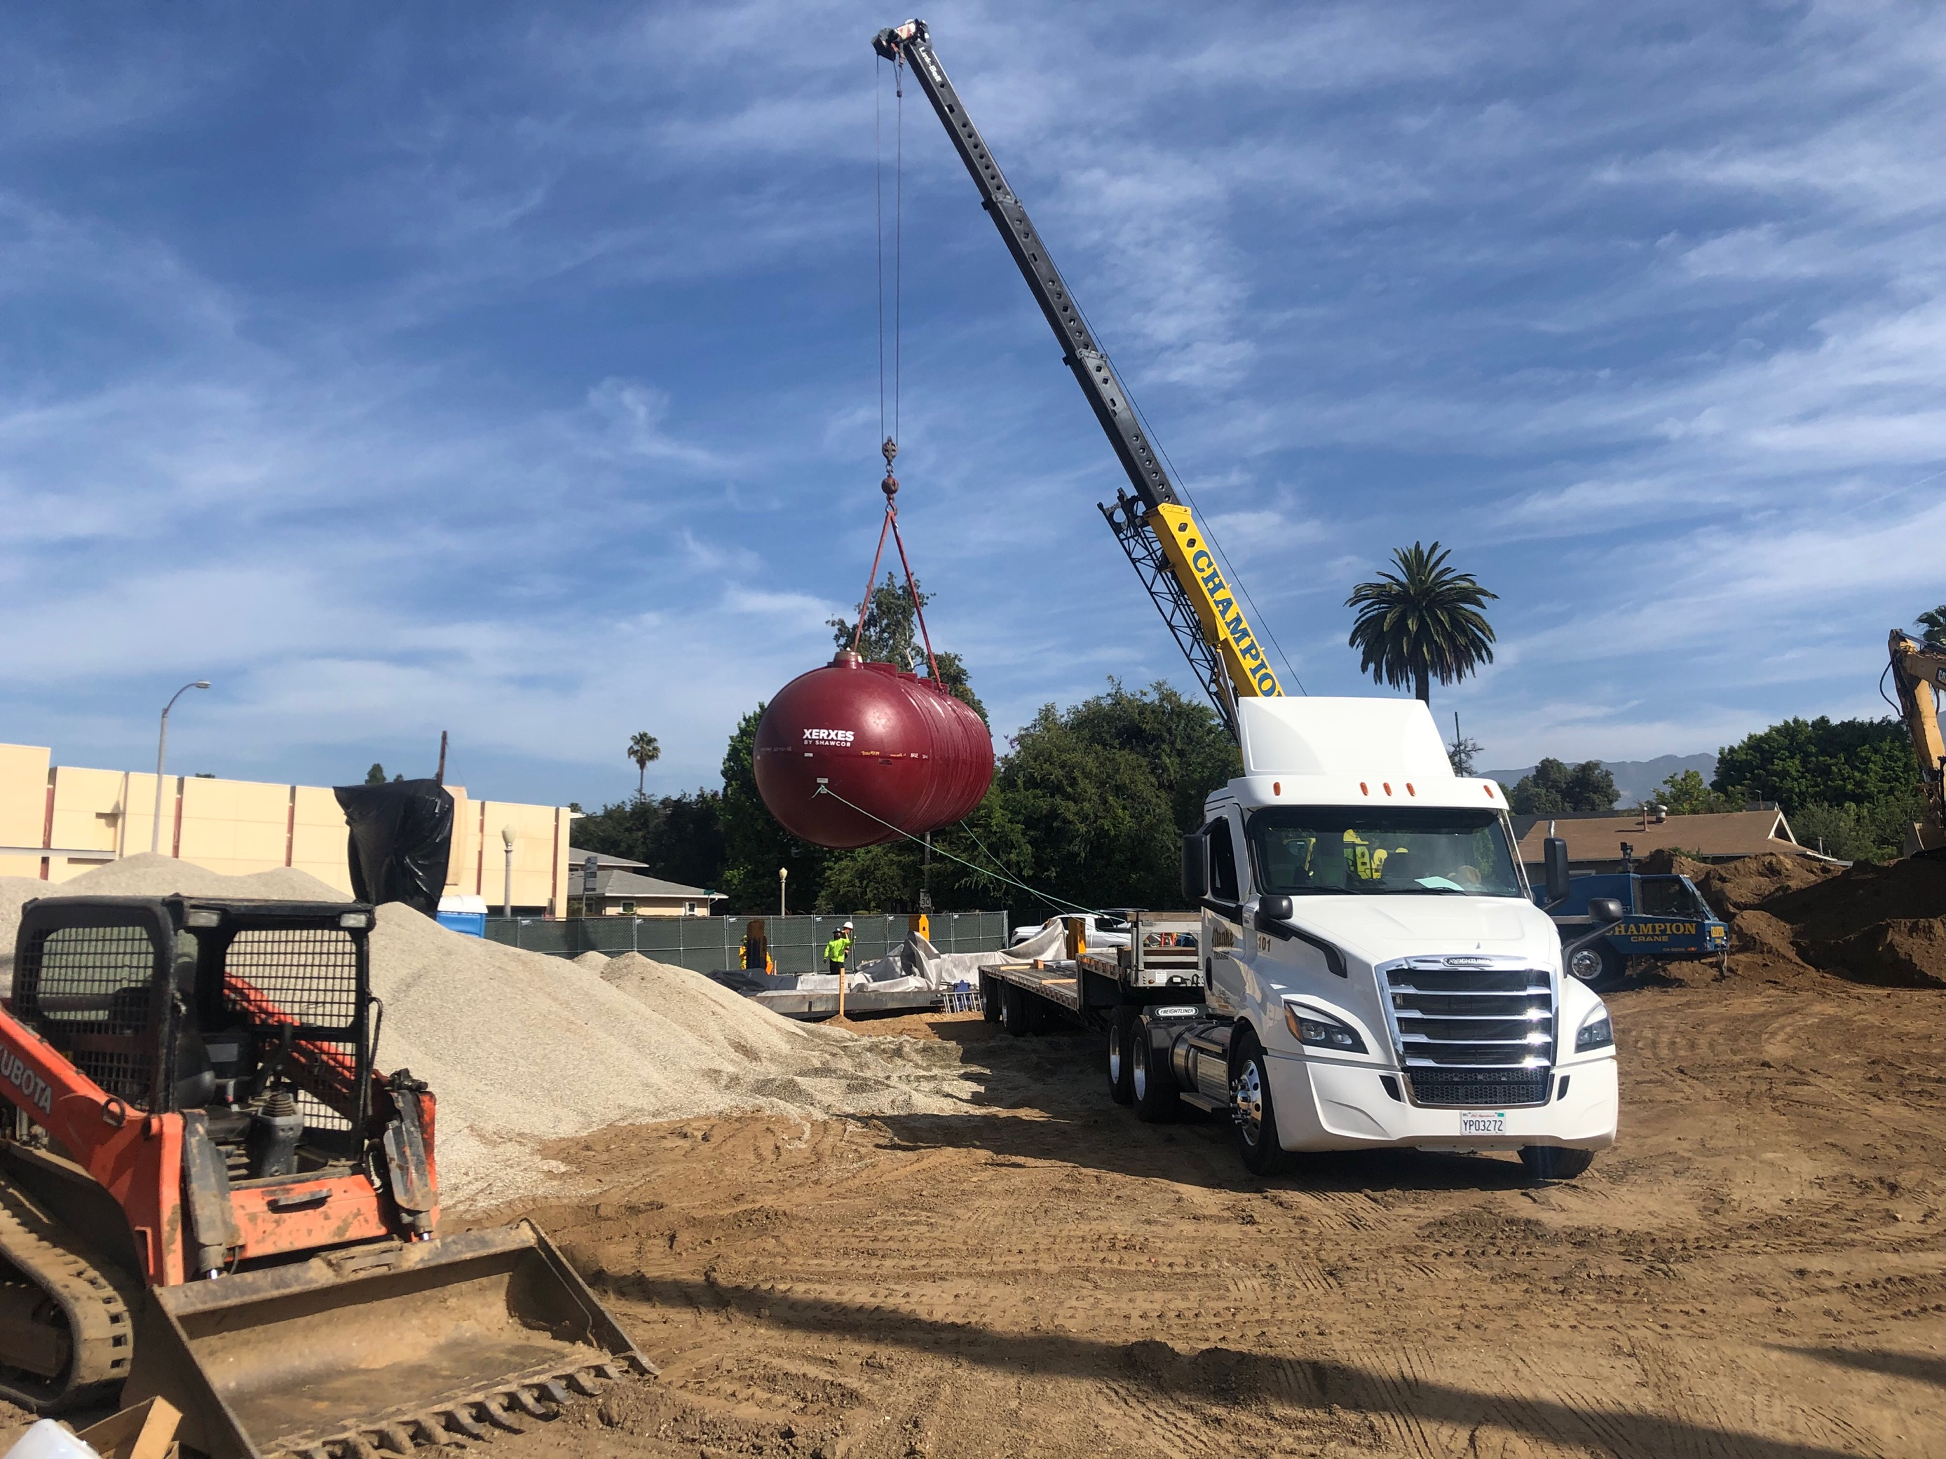
Underground
Storage Tanks
(UST) Closure
Roohi Toosi, PE
Jay Sandoval, CIH
Patrick Naffah, CIH
Mclean Reich
Robert Smith
Johnny Wales

Slide 2
McLean Reich RUST, EAR, Reporting Section Manager mclean.reich@waterboards.ca.gov
To preserve, enhance, and restore the quality of California’s water resources and drinking water for the protection of the environment, public health, and all beneficial uses, and to ensure proper water resource allocation and efficient use, for the benefit of present and future generations.
The lead agency in overseeing USTs in California
Provides Funding and Technical Assistance for UST Closure and Cleanup that are mandated by regulations
Regional Water Boards are the oversight agencies for LUST Cases
Robert Smith
RUST, EAR, LOP Program Manager
Robert.Smith@waterboards.ca.gov
Johnny Wales
Environmental Specialist
johnny.wales@redhorsecorp.com

Slide 3
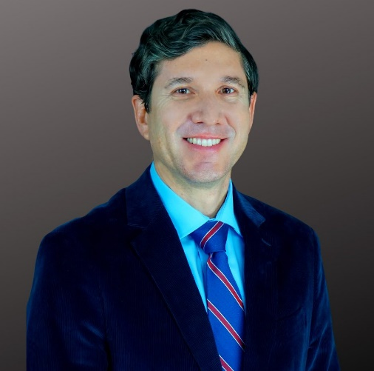
Jay Sandoval, CIH, is A-Tech’s Senior Industrial Hygienist and is an expert with 15+ years of experience in UST removal investigation and site closure.
Presenters
A full-service environmental engineering, hydrogeology, and environmental health & safety consulting firm:
Founded in 2002
4 Offices in the Western US
85+ Employees
The Inc. 5,000 (5 Years Running!)
UST Removal Experts
Roohi Toosi, PE, is A-Tech’s Director of Engineering and is an expert with 8+ years of experience in UST removal investigation and site closure.
Patrick Naffah, CIH, is A-Tech’s Senior Industrial Hygienist with 6+ years of experience in environmental industry.

Slide 4
Questions We’ll Be Answering
What is a UST? What does UST Closure Mean?
Why are USTs regulated and why are we talking about their closure?
Which USTs are subject to Closure?
UST Regulations in California
Current Mandate
What H&SC 25291(a)(1)-(6) require?
Industry Standards for Compliance
Example Non-Compliant Systems
Is there any funding available?
RUST Grant Option
RUST Loan Option
What would happen if I do not comply with the H&SC requirements?
What is the process for UST Closure?
What factors affect the UST Closure cost and timeline?

Slide 5
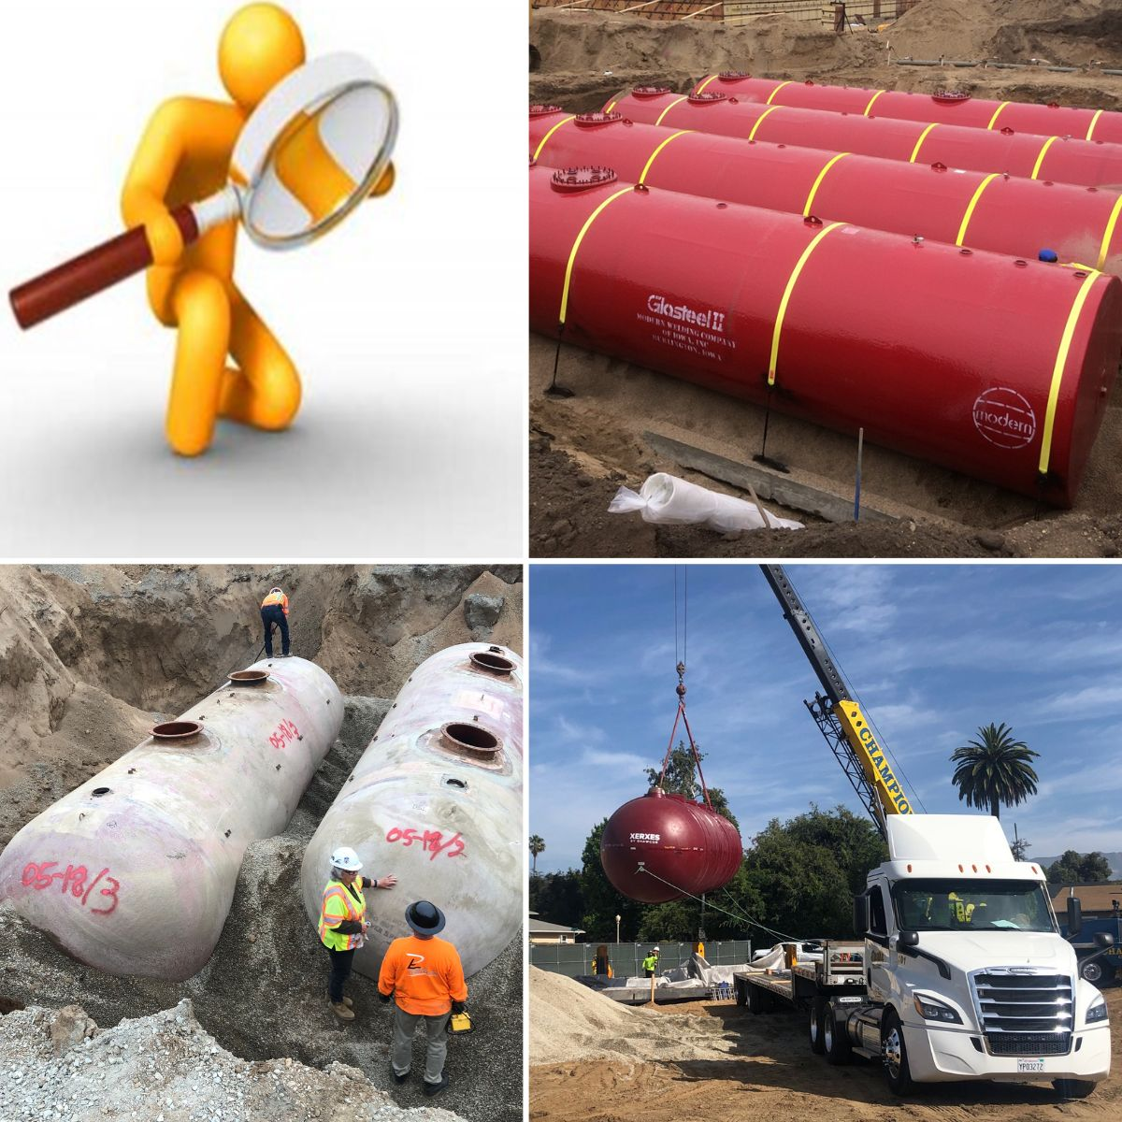
What is a UST?

Slide 6
Why are USTs Regulated and Why Should Some be Closed?
Environmental and Regulatory Concerns
Between 2017-2020: 1 in 4 UST closures resulted in a leaking case
Impacts to the environment that can result in costly remediation
There is a current mandate on UST closure with deadline of December 31, 2025.

Slide 7
Which USTs are Subject to Closure?
UST Regulations in California
California Health & Safety Code, Statutes of Chapter 6.7, Underground Storage of Hazardous Substances (link)
California Health and Safety Code (H&SC) Section 25292.05
USTs installed after January 1, 1984 shall comply with the requirements of H&SC 25291(a)(1)-(6)
The H&SC 25291(a)(7), however allowed USTs that are installed before January 1, 1997 for storing motor vehicle fuels to be designed and constructed with other requirements in in lieu of the requirements of paragraphs (1) to (6), but that will not be the case after December 31, 2025.
No Longer an Exception!
H&SC Section 25292.05
Design Standards:
H&SC 25291(a)(1)-(6)

Slide 8
Which USTs are Subject to Closure?
Current Mandate
Senate Bill 445, became effective on September 25, 2014
Amended State Law, the California Health and Safety Code (H&SC) Section 25292.05
Requires all USTs, regardless of construction year, to comply with the requirements of H&SC 25291(a)(1)-(6)
All single-walled USTs/pipes to be permanently closed by:
DECEMBER 31, 2025

Slide 9
Which USTs are Subject to Closure?
What H&SC 25291(a)(1)-(6) require?
(a) USTs *and* associated piping shall be designed and constructed to have primary and secondary containment with these standards:
(a)(1) Primary containment shall be product-tight and compatible with the stored product
(a)(2) Secondary containment shall not be reactive with the hazardous material and be able to store it for maximum emergency time
(a)(3) If there is only one tank, secondary containment shall be large enough to contain 100% of the primary tank
(a)(4) If there are multiple tanks, secondary containment shall contain the greater of 150% of the largest tank or 10% aggregate of all tanks
(a)(5) The secondary containment shall be capable to handle stormwater (not an issue with double-walled)
(a)(6) The outer shell must be constructed of nonearthen materials which provide structural support, with continuous leak detection with alarm located in the space between the shells, capable of detecting entry of either hazardous substances or water

Slide 10
Which USTs are Subject to Closure?
What H&SC 25291(a)(1)-(6) require? (cont.)
Primary and secondary containment
Product-tight and compatible with the stored product
Non-reactive secondary containment
Able to store it for maximum emergency time
Single tank: secondary containment shall be large enough to contain 100% of the tank’s volume
Multiple tanks: secondary containment contains the greater of 150% of the largest tank or 10% aggregate of all tanks
The secondary containment contains maximum volume of a 24-hour rainfall as determined by a 25-year storm history

Slide 11
Which USTs are Subject to Closure?
Industry Standards for Compliance
H&SC 25291(a)(6) clarifies that USTs have met the requirements of primary and secondary containment if:
The outer shell is from nonearthen materials such as concrete, steel, plastic, fiberglass, etc.
Continuous leak detection system that can detect entry of hazardous material from the inner shell to the space between shells
Continuous leak detection system that can detect entry of water from the outer shell to the space between shells
Double-Walled is a Solution

Slide 12
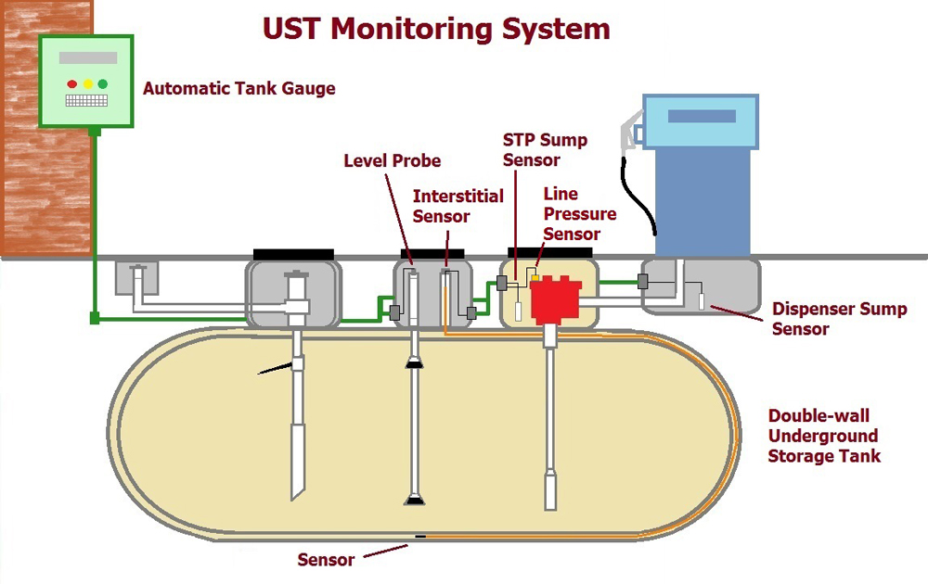
* Reference: picture was extracted from https://www.commtank.com/tank-articles/underground-storage-tank-monitoring-systems/

Slide 13
Which USTs are Subject to Closure?
Example Non-Compliant Systems
Single-Walled Tank *or* Single-Walled Piping
Single-Walled Tank with Exterior membrane liner and monitoring wells to detect releases
Double-Walled Tank and Single-Walled Piping

Slide 14
Grant Program: RUST (Replacing, Removing,
or Upgrading Underground storage Tanks)
Is There Any Funding Available?
Small business UST Owners/Operators residing in CA may apply
Independently owned/operated
Under 20 employees
Less than 1,500,000 gallons sold per year
Facility actively retailing gasoline within previous 2 years
Tanks owned and operated in compliance with H&S code chapter 6.7 and EVR requirements ***
Waiver of compliance and actively retailing gasoline requirements available Apply for funding via State Water Board’s Division of Financial Assistance: https://faast.waterboards.ca.gov/
Applications processed on a first-come, first served basis - DON’T WAIT!
Up to $70,000 per business entity for petroleum USTs
See full eligibility/ineligibility requirements

Slide 15
Is There Any Funding Available?
Loan Program: RUST (Replacing, Removing,
or Upgrading Underground Storage Tanks)
$10K to $750K maximum per entity
10- or 20-year terms
Below Market Interest Rate: (2.0%)
Financing up to 100 percent of costs to upgrade, remove, or replace USTs
Two percent (2%) loan fee
Must be UST owner and/or operator - Meeting following requirements:
Tanks owned/operated must comply with H&S Code chapter 6.7 and EVR requirements, unless the work will bring them into compliance
Demonstrate ability to repay loan and possess adequate collateral;
Must be in compliance, or will comply with, financial responsibility requirements
Applications can be field directly with the State Water Board via FAAST
See full eligibility/ineligibility requirements

Slide 16
RUST Links and Contacts
RUST Webpage
https://www.waterboards.ca.gov/water_issues/programs/ustcf/rust.html
Grants Fact Sheet
https://www.waterboards.ca.gov/water_issues/programs/ustcf/docs/rust/rust_grant_fact_sheet_04_22.pdf
Loans Fact Sheet
https://www.waterboards.ca.gov/water_issues/programs/ustcf/docs/rust/rust-loan-fact-sheet_04_22.pdf
Contact Information
Email: RUST@waterboards.ca.gov
Phone: (916) 323-2095

Slide 17
What Would Happen if I Do Not Comply?
Be Proactive
Costs and Fines
Beginning January 1, 2026
Non-Compliant USTs may be “red-tagged” (prevents fuel dispensing or delivery.
Penalties between $500-$5000 per day, per tank, per violation

Slide 18
Common Services Required for Removal,
Retrofitting, and Updating
What are some Examples of UST Closure Activities?
Permitting process through the appropriate CUPA agency and/or Fire Departments, County’s Health Divisions, Air Quality Districts, and maybe Regional Water Quality Board
Construction work: excavation, removal, waste transport, and backfilling activities
Environmental monitoring during construction for potential air exposure
Confirmation sampling to assess any potential leakage from the USTs
CIH assessment and certification of Tank Destruction
Preparing the final closure report and obtaining no-further-action (NFA) letter
Permanent closure in place may be required in certain situations, usually due to safety concerns with the use of a crane for UST removal (not RUST-eligible)

Slide 19
Factors to Consider
What Factors Affect The UST Closure Cost and Timeline?
Type of client: Government, small business, etc.
Type of sites: gas station, airport, powerplants, etc.
The local oversight agency
Prior releases and contamination at the Site
Number of tanks that are being closed
Length of associated piping that needs to be removed
Number of samples that needs to be taken
The number of shifts that air monitoring is required
Special Considerations Example: Airport requires crane notification that takes upward of 45 days

Slide 20
Questions?
Jay Sandoval
jay@atechinc.net
Robert Smith
Robert.Smith@waterboards.ca.gov
Roohi Toosi Roohi@atechinc.net
McLean Reich mclean.reich@waterboards.ca.gov
Patrick Naffah
Patrick@atechinc.net
Johnny Wales
johnny.wales@redhorsecorp.com

