Slide 1
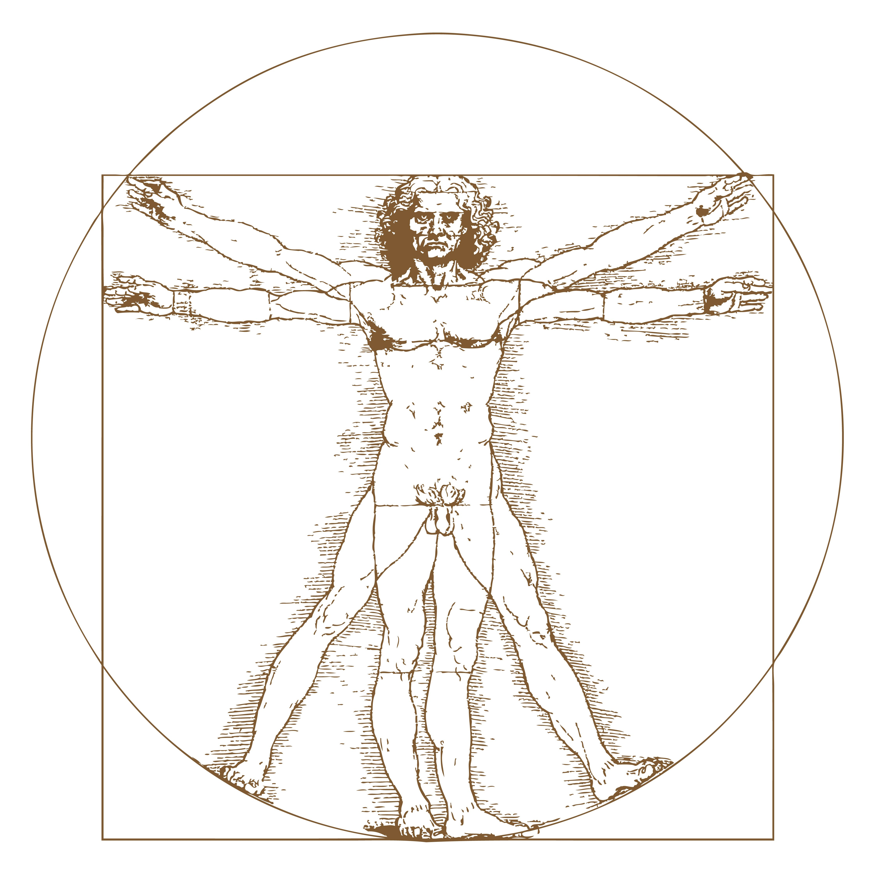
Ergonomics 101
Part 1 of 3
Kai Chiu, PE, CSP, CIH, CPE, CPCU, MBA
Patrick Naffah, CIH
Add Questions in the Q&A Chat!
Notes:
Patrick

Slide 2
Presenters
A full-service environmental engineering, hydrogeology, and environmental health & safety consulting firm:
Founded in 2002
4 Offices in the Western US
85+ Employees
Kai Chiu, PE, CSP, CIH, CPE, CPCU, MBA is an Environmental Health and Safety Professional with over 30 years of experience in the industry.
Ergonomics Experts
Patrick Naffah, CIH is A-Tech’s Senior Industrial Hygienist with over 7 years of experience in the industry.
Notes:
Patrick

Slide 3
Illustrated Example
Notes:
Patrick

Slide 4
Lessons Learned
Lessons Learned
Early Intervention/Quick Response is Key
Evaluation by Certified Professional Ergonomist (CPE)
Results
Cost Savings (e.g., Reduce/Defend Worker’s Comp Claims)
Improve Morale
Maintain Productivity
Injury Prevention
Notes:
Kai

Slide 5
Today’s Topics
What is Ergonomics?
Historical and Modern-Day Ergonomics
Ergonomics Categories:
Macro Ergonomics:
Work Systems
Organization/Management
Micro Ergonomics:
Workstation Design
Body Mechanics
Minimize MSD
Potential Consequences of Poorly Designed Workstation
Other Considerations
Notes:
Patrick

Slide 6
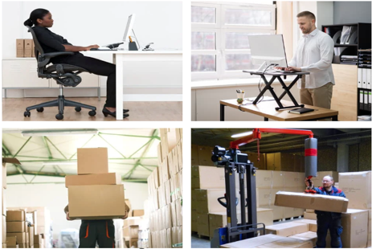
Part 2: Office Ergonomics (Office & WFH)
Part 3: Non-Office Ergonomics
Parts 2 & 3 Subjects
Protecting Employees
Reducing/Defending Worker’s Comp Claims
Preventing Musculoskeletal Disorders (MSD)
What’s Next?
Office
Non-Office
Notes:
Patrick

Slide 7
Ergo (Work)
Nomics (Study)
What is Ergonomics?
Science concerned with designing work settings to efficiently interact (fitting) with people
Science is typically:
(i) Observable
(ii) Quantifiable
(iii) Predictable
Notes:
Kai

Slide 8
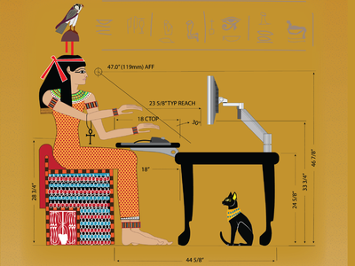
History of Ergonomics
Legend says it started way back with the pyramids, Great Wall…
Notes:
Kai

Slide 9
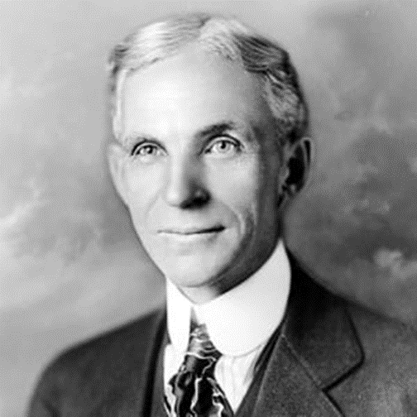
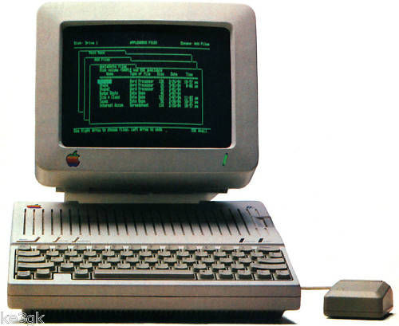
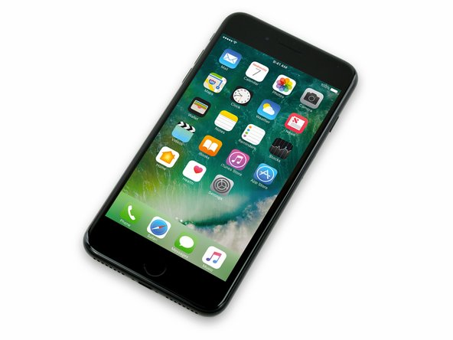
History of Ergonomics
5,000 BC
20th Century
Industrial Revolution
Industrial Engineering (the Assembly Line)
Henry Ford utilized a simple ergonomics principle and help Ford Motor became leader of the auto industry at his time.
Personal Management Devices
Notes:
Kai

Slide 10
Latest Ergonomics Developments
Macro Ergonomics
Micro Ergonomics
Notes:
Kai

Slide 11
Macro Ergonomics
Work Systems
Study of interactions between humans and their environment
Developments Reducing Human Error
Socio-Technical Systems
Artificial Intelligence (AI)
Healthcare Information Technologies
High Reliability Organizations
Hospitals
Airlines
Notes:
Kai

Slide 12
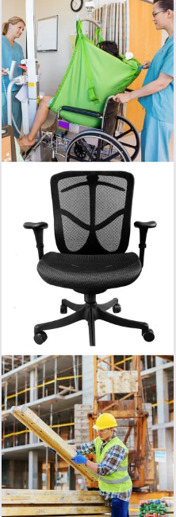
Micro Ergonomics
Micro Ergonomics Examples
Workstation Design (office and non-office)
Work From Home (WFH) Designs
Work Practices
Body Mechanics
Minimize Musculoskeletal Disorders (MSD)
Current Developments
Cal/OSHA Standards
Section 5110 (Repetitive Motion Injuries)
Section 5120 Health Care Worker Back and Musculoskeletal Injury Prevention
Workers Compensation
Notes:
Kai

Slide 13
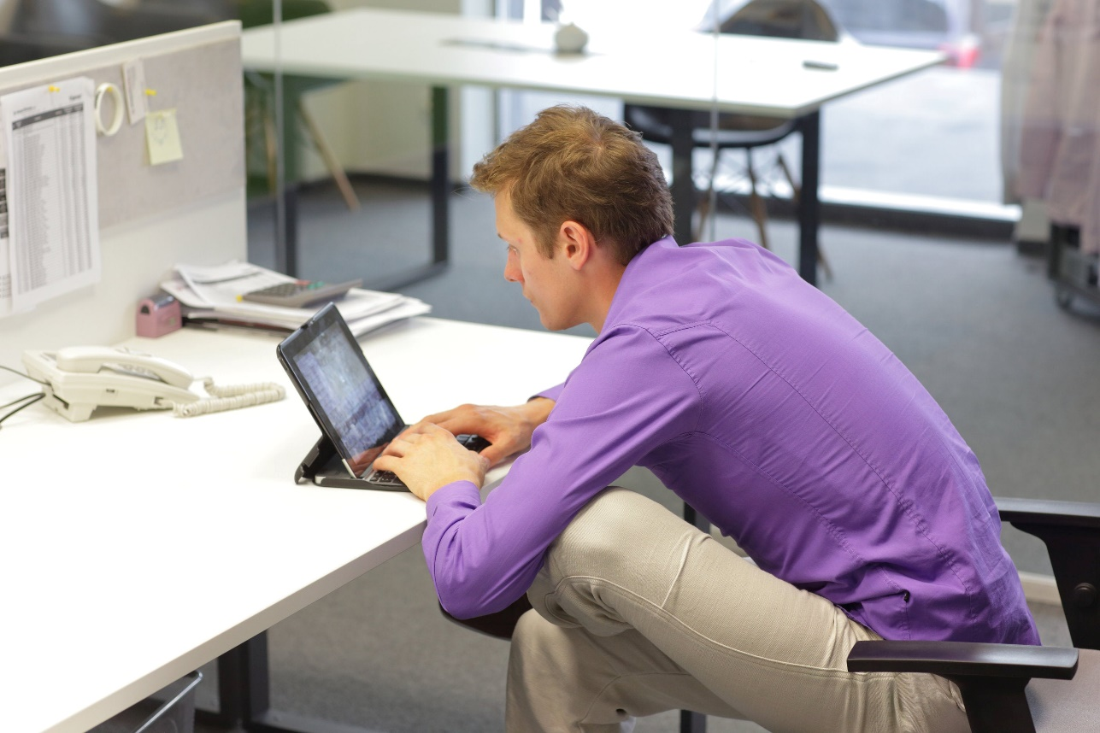
Consequences of a Poorly Designed Workstation
Ever
Been
Here?
Unfortunate consequences include MSD:
Carpal tunnel syndrome
Tendinitis
Rotator cuff injuries (shoulder)
Epicondylitis (Tennis elbow)
Trigger finger
Muscle strains and low back injuries
Employer Action Items – Early Action is Critical!
Provide ergonomic evaluations to employees
Provide ergonomic training and ergonomically-friendly equipment
Notes:
Patrick

Slide 14
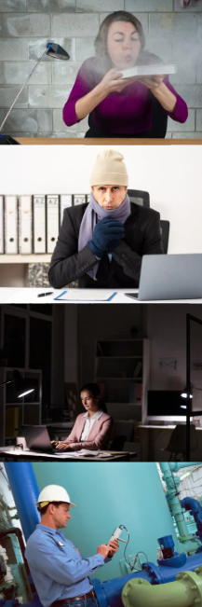
Other Workplace Considerations
Air Quality
Indoor Temperature
Lighting Conditions
Workplace Health and Safety
(e.g., Noise, Vibration)
Notes:
Patrick

Slide 15
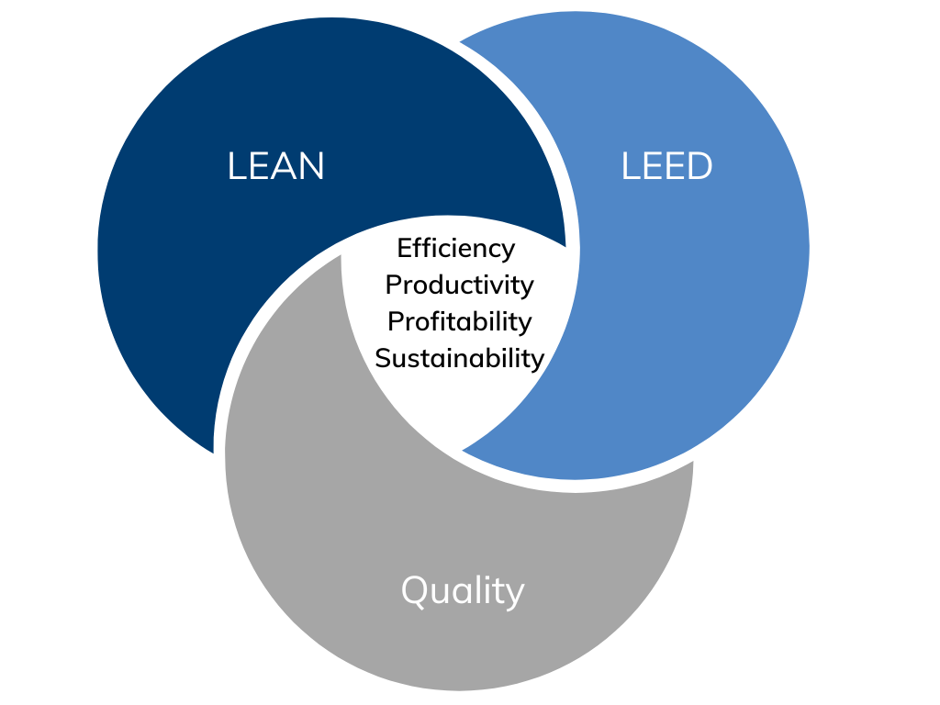
Formula for Success
Other Initiatives
Notes:
Kai

Slide 16
Coming Soon!
Remember to Stay Tuned:
Part 2: Office Ergonomics (Office/WFH)
Part 3: Non-Office Ergonomics
Sign Up to Learn:
Proper Work Practices
Ergonomically Friendly Work Setups
Steps to Injury Prevention
Escalating MSD Concerns
More!
Notes:
Patrick

Slide 17
Questions?
Kai Chiu
Kai@atechinc.net
Patrick Naffah
Patrick@atechinc.net
Contact us with any health and safety questions!
Notes:
Patrick

