Slide 1
OEHS Compliance 2023
Cal/ OSHA
Cal/ CUPA
Ralph Sbragia, CSP, CHST
Roosevelt Ward, CIH, CSP, QISP
Brandon Montes

Slide 2
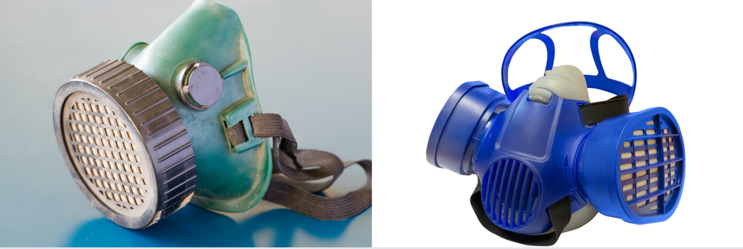
Topics
Airborne Contaminants/COVID
Respiratory Protection
Hazard Communication
Hazardous Materials Business Plan

Slide 3
Airborne Contaminants
Airborne Contaminants | ATD | COVID-19
COVID-19 Prevention/Aerosol Transmissible Disease
CCR - Title 8 Sections 3205 & 5199
Non-Emergency Regulations Approved by OAL Feb. 2023 – in effect until 2/2025
Follows recommendations of CDPH (CDPH 09/20/22 Memo)
Must be included in your IIPP as a workplace hazard
Review and understand updated Close Contact definition
Airborne Contaminants
CCR - Title 8 Section 5155 Airborne Contaminants
No Advisory Committees calendared currently for updates
Several metal welding/heating byproducts (Mg, Zn, etc.) are being informally discussed
Know your processes and by products
Develop JHA/JSA documentation/Train/implement
Notes:
What you should know:
What you should do:
What you should have done:
Case Studies:

Slide 4
CCR - Title 8 Section 5144
Know your processes and by products
Develop JHA/JSA documentation/Train/implement
Update your lists of affected Job Classes/personnel
Audit your Respiratory Protection program
Is it effective?
Are applicable job functions included?
Have there been changes to your hazards?
Fit Testing
Voluntary versus Mandatory
Up to date?
Records complete?
Device Inventories adequate?
Respiratory Protection
Notes:
What you should know:
What you should do:
What you should have done:
Case Studies:

Slide 5
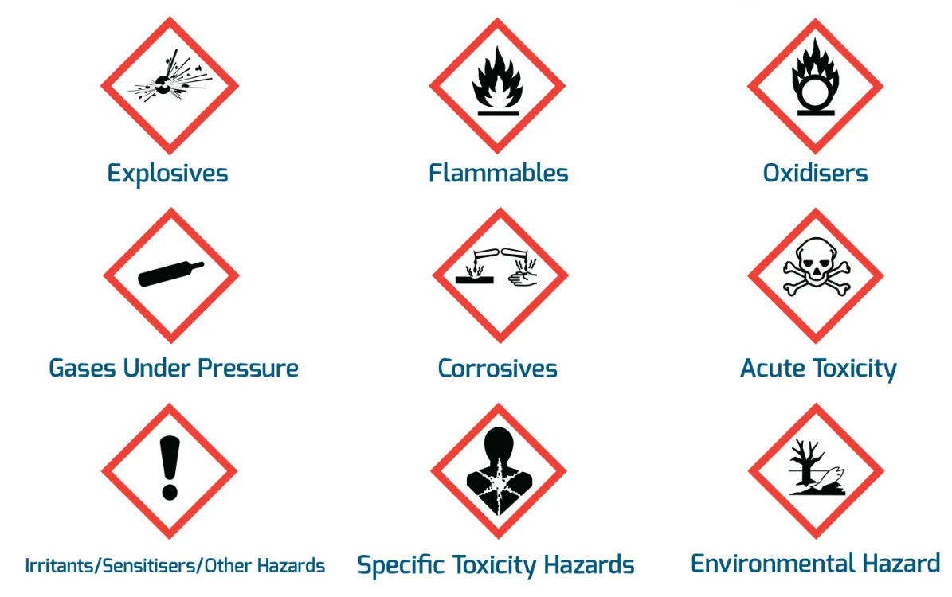
CCR - Title 8 Section 3203 – General Hazards
Key section of your IIPP
Records of regular site reviews/audits/inspections
Records of how these finding are communicated
Training!!
CCR - Title 8 Section 5194 – Chemical Hazards
Are you still using MSDS?
Have you incorporated the GHS?
When did you last Audit your records?
Hazard Communication
Notes:
What you should know:
What you should do:
What you should have done:
Case Studies:

Slide 6
Hazardous Materials Business Plan Overview (Cal-CUPA)
What do you need to know.
Is my business subject to HMBP requirements?
How to Comply with Federal, State, and Local Reporting Requirements?
HMBP Updates 2023
Note: CAL EPA – Unified Programs Publications, Guidance and Forms for Reporting

Slide 7
Hazardous Materials Business Plan Overview (Cal-CUPA)
Is my business subject to HMBP requirements?
Do you have Hazardous Materials, Hazardous Waste, Medical Waste, or Universal Waste in quantities ≥ 55 gallons, 500 pounds, or 200 cubic feet?
and/or
Do you have any quantity of a highly toxic compressed gas?

Slide 8
Hazardous Materials Business Plan Overview (Cal-CUPA)
How to Comply with Federal, State, and Local Reporting Requirements?
The Emergency Planning and Community Right-to-Know Act (EPCRA)
Enacted by Congress to help local communities protect public health, safety, & the environment from chemical hazards.
Federal Reporting Requirements - EPCRA Tier II The Emergency Planning Community Right to Know Act (EPCRA) requires industry to disclose chemical storage, chemical use, and chemical releases.
Due March 1st
Owners and operators are required to prepare and have available the required documentation completed and submitted annually on
When properly completed and implemented, the Hazardous Materials Business Plan (HMBP) meets EPCRA Tier II Reporting requirements.
Notes:
Notes for Roosevelt:
Title 17 CCR Div. 1, Chapter 5, (4)(4.5)- Sanitation (Environmental) Radiologic Technology
Title 17 CCR 30336.7 – Radiation Machine Radiation Safety Officer Requirements
Title 17 CCR 30500-30543- (Subchapter 4.7) Nuclear Medicine Technology
Title 17 CCR 30253- Standards for Protection Against Radiation [10 CFR 20]
Applicable Regulations for Laser use and Laser Safety Officer (LSO):
29 CFR 1910- (1910.132, 1910.133) General requirements, Eye and Face Protection for Laser Hazards in Construction
International Electrotechnical Commission (IEC) 60825- Safety of Laser Products
National Fire Protection Association (NFPA) 115: Standard for Laser Fire Protection
American National Standards Institute (ANSI) Z136.1, Z136.3- American National Standard for Safe use of Lasers, in Health Care
https://www.osha.gov/laser-hazards/standards
https://www.cdph.ca.gov/Programs/CEH/DRSEM/Pages/RHB-LawsAndRegs.aspx#

Slide 9
Hazardous Materials Business Plan Overview (Cal-CUPA)
The HMBP includes four (4) elements covered in detail:
Business Activities and Owner/Operator Identification
Information provides notification to the local CUPA that apply to the facility and detailed information about the business.
Hazardous Material Inventory & Site Map
The chemical inventory - A list of the hazardous materials subject to reporting that are stored/handled at the facility.
Emergency Response Plan and Employee Training
The Hazardous Materials Business Plan (HMBP) contain Emergency Response Plans and procedures
Contingency Plan for Hazardous Waste Generators
Designed to minimize hazards to humans and the environment from a sudden release of a hazardous waste, fires, or explosions.

Slide 10
Hazardous Materials Business Plan Updates (Cal-CUPA)
Assembly Bill 2059 was approved on September 13, 2022 and is effective on January 1, 2023.
In summary, the bill:
1) Expands the scope of hazardous materials subject to regulation by narrowing the definition of “consumer product & retail establishment”.
2) Requires a “supplier”, as defined, that sells or provides a certain quantity of hazardous materials meeting certain requirements to a business in the state in certain quantities to maintain records containing specified information regarding the sale or provision of the hazardous materials

Slide 11
Hazardous Materials Business Plan Updates (Cal-CUPA)
3)The bill requires a handler to notify the UPA if hazardous materials in certain quantities are to be:
Removed from the storage; or
Removed from handling location and transferred to another location; and
To disclose to the UPA certain information regarding the transfer.
Notes:
Notes for Roosevelt:
CAL-OSHA Standard 5110: Repetitive Motion Injuries standard applies when a licensed physician has identified the RMI. Then a worksite evaluation, prevention controls, and worker-training is required.
Research sources: https://www.cdph.ca.gov/Programs/CCDPHP/DEODC/OHB/HESIS/CDPH%20Document%20Library/phyguide.pdf

Slide 12
Hazardous Materials Business Plan Overview (Cal-CUPA)
Ask your local inspector
California defines both 'Regulated Waste' and 'Hazardous Waste'; could you please explain the differences between California & Fed.?
What are the ramifications for a business if their HMBP update is not uploaded by tomorrow (3/1)?
How can a business owner/manager make an HMBP Inspection go smoothly?
Notes:
Notes for Roosevelt:
CAL-OSHA Standard 5110: Repetitive Motion Injuries standard applies when a licensed physician has identified the RMI. Then a worksite evaluation, prevention controls, and worker-training is required.
Research sources: https://www.cdph.ca.gov/Programs/CCDPHP/DEODC/OHB/HESIS/CDPH%20Document%20Library/phyguide.pdf

Slide 13
Questions?
Ralph Sbragia
ralph@atechinc.net
Roosevelt Ward
Roosevelt@atechinc.net

Slide 14
A-Techs Services – One Stop Shop

